Slide 1

Why the Common Core?: How these Standards are Different
Notes:
This module was last updated on February 2016.

Slide 2
Why are we doing this? We have had standards.
Before Common Core State Standards we had standards, but rarely did we have standards-based instruction.
Long lists of broad, vague statements
Mysterious assessments
Coverage mentality
Focused on teacher behaviors – “the inputs”

Slide 3
Results
Previous state standards did not improve student achievement.
Gaps in achievement
Gaps in expectations
NAEP results
ACT 2012 data – College Readiness Benchmark
  All 4 subject areas: 25%
  3 subject areas: 15%
  2 subject areas: 17%
  1 subject area: 15%
  None 28%
College remediation rates

Slide 4
What are our expectations?
Based on the beliefs that
A quality education is a key factor in providing all children with opportunities for their future
It is not enough to simply complete school, or receive a credential – students need critical knowledge and skills
This is not a 12th grade or high school issue. It is an education system issue.
Quality implementation of the Common Core State Standards is a necessary condition for providing all students with the opportunities to be successful after high school.

Slide 5
Principles of the CCSS
Fewer - Clearer - Higher
Aligned to requirements for college and career readiness
Based on evidence
Honest about time

Slide 6
ELA/Literacy: 3 shifts
Regular practice with complex text and its academic language
Reading, writing, and speaking grounded in evidence from text, both literary and informational

Slide 7
Non-Examples and Examples
Not Text-Dependent
Text-Dependent
In “Casey at the Bat,” Casey strikes out. Describe a time when you failed at something.
In “Letter from a Birmingham Jail,” Dr. King discusses nonviolent protest. Discuss, in writing, a time when you wanted to fight against something that you felt was unfair.
In “The Gettysburg Address” Lincoln says the nation is dedicated to the proposition that all men are created equal. Why is equality an important value to promote?
What makes Casey’s experiences at bat humorous?
What can you infer from King’s letter about the letter that he received?
“The Gettysburg Address” mentions the year 1776. According to Lincoln’s speech, why is this year significant to the events described in the speech?

Slide 8
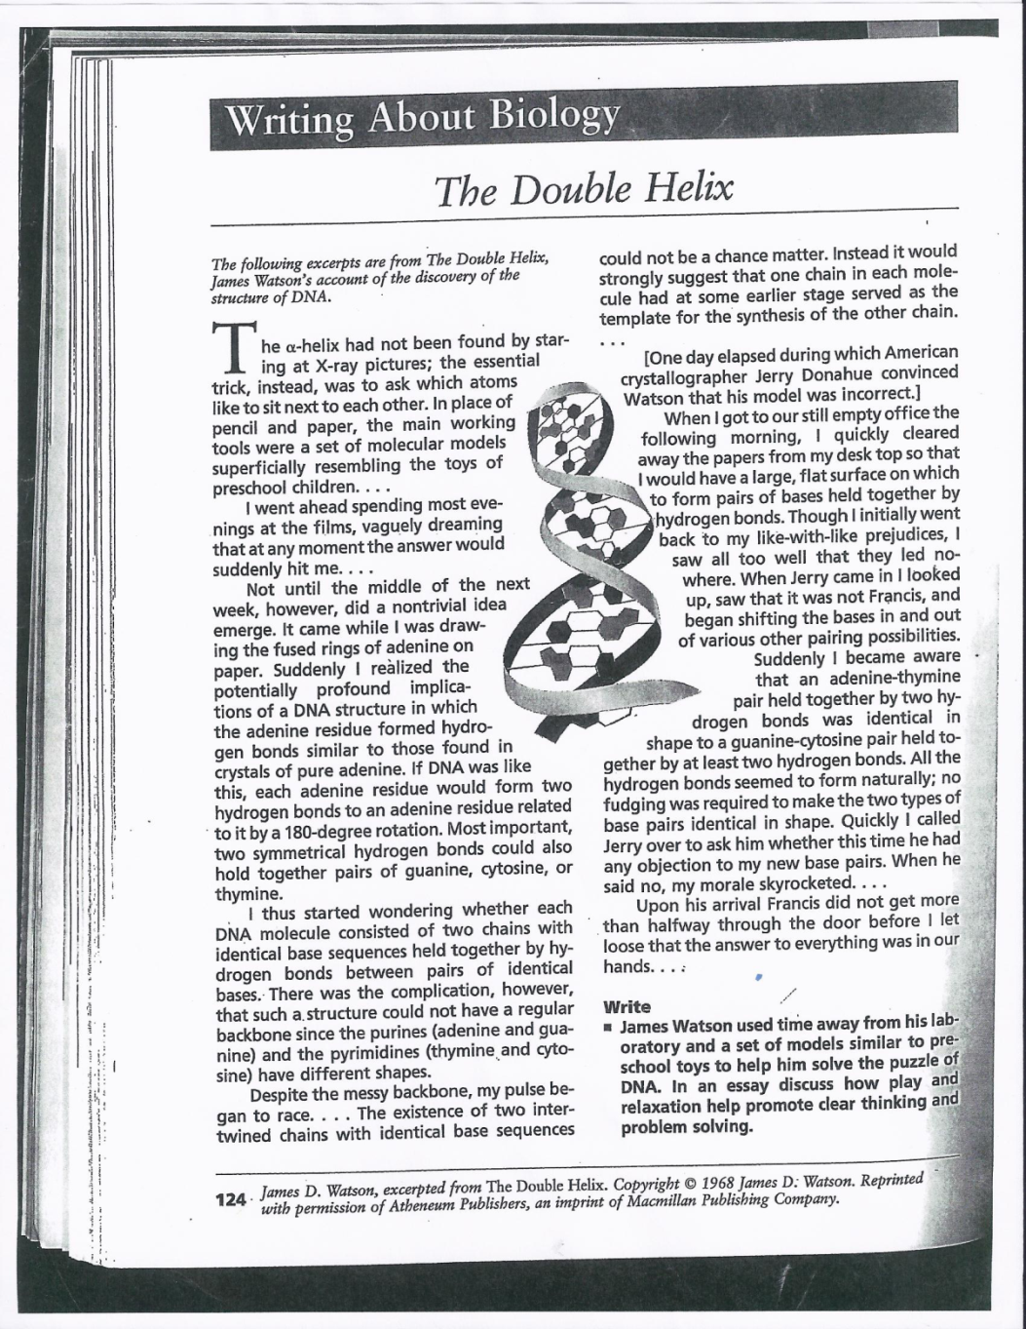
Example?
James Watson used time away from his laboratory and a set of models similar to preschool toys to help him solve the puzzle of DNA. In an essay discuss how play and relaxation help promote clear thinking and problem solving.

Slide 9
ELA/Literacy: 3 shifts
Regular practice with complex text and its academic language
Reading, writing, and speaking grounded in evidence from text, both literary and informational
Building knowledge through content-rich nonfiction

Slide 10
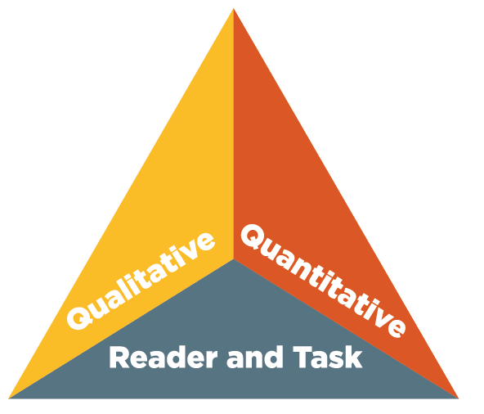
Text Complexity
Appendix A
Supplement to Appendix A
Appendix B
CCSS address what and how students read.

Slide 11
Mathematics: 3 shifts
Focus: Focus strongly where the Standards focus.

Slide 12
Traditional U.S. Approach
 | K 12
Number and Operations
Measurement and Geometry
Algebra and Functions
Statistics and Probability

Slide 13
Focusing attention within Number and Operations
 | Operations and Algebraic Thinking |  |  |  |  |  |  | Expressions and Equations |  |  |  | Algebra
 |  |  |  |  |  |  | → |  |  |  | →
 | Number and Operations—Base Ten |  |  |  |  |  | → | The Number System
 |  |  |  |  |  |  |  |  |  |  | →
 |  |  |  | Number and Operations—Fractions |  |  | →
 | K | 1 | 2 | 3 | 4 | 5 |  | 6 | 7 | 8 |  | High School

Slide 14
Priorities in Mathematics
Grade | Focus Areas in Support of Rich Instruction and Expectations of Fluency and Conceptual Understanding
K–2 | Addition and subtraction, measurement using whole number quantities
3–5 | Multiplication and division of whole numbers and fractions
6 | Ratios and proportional reasoning; early expressions and equations
7 | Ratios and proportional reasoning; arithmetic of rational numbers
8 | Linear algebra and linear functions

Slide 15
Mathematics: 3 shifts
Focus: Focus strongly where the Standards focus.
Coherence: Think across grades, and link to major topics within grades.

Slide 16
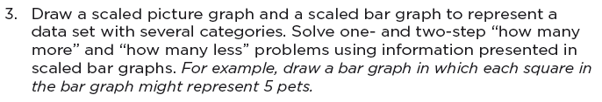
Coherence: Link to major topics within grades
Example: data representation
Standard 3.MD.3

Slide 17
Mathematics: 3 shifts
Focus: Focus strongly where the Standards focus.
Coherence: Think across grades, and link to major topics within grades.
Rigor: In major topics, pursue conceptual understanding, procedural skill and fluency, and application.

Slide 18
Required Fluencies in K-6
Grade | Standard | Required Fluency
K | K.OA.5 | Add/subtract within 5
1 | 1.OA.6 | Add/subtract within 10
2 | 2.OA.2 2.NBT.5 | Add/subtract within 20 (know single-digit sums from memory) Add/subtract within 100
3 | 3.OA.7 3.NBT.2 | Multiply/divide within 100 (know single-digit products from memory) Add/subtract within 1000
4 | 4.NBT.4 | Add/subtract within 1,000,000
5 | 5.NBT.5 | Multi-digit multiplication
6 | 6.NS.2,3 | Multi-digit division Multi-digit decimal operations

Slide 19
Mathematical Practices
Make sense of problems and persevere in solving them.
Reason abstractly and quantitatively.
Construct viable arguments and critique the reasoning of others.
Model with mathematics.
Use appropriate tools strategically.
Attend to precision.
Look for and make use of structure.
Look for and express regularity in repeated reasoning.
Don’t Bureaucratize

Slide 20
Power of the Shifts
Know them – both the what and the why
Internalize them
Apply them to your decisions about
  Time
  Energy
  Resources
  Assessments
  Conversations with parents, students, colleagues
Continue to engage with them:
  www.achievethecore.org
  Follow @achievethecore on Twitter

